Slide 1




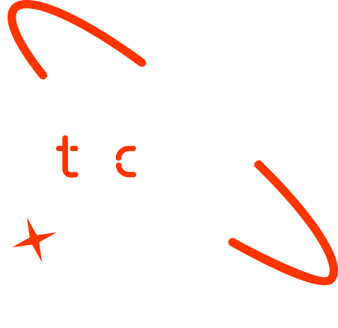

Smart Spending Watchdogs: Using Machine Learning to Detect Anomalies in Financial Transactions
Group Name 1. Ayana Damtew Tajebe
2. Beamlak Dejene
3. Anwar Mohammed Koji
4. Anwar Gashaw Yimam
5. Amen Zelealem Tadese
Date: 6/4/2025 G.C

Slide 2

Outline
Concept note and implementation plan
Background
Objectives
SDG Relation
Data
Data Collection
Exploratory Data Analysis et Feature Engineering
Model
Model Selection and Training
Model Evaluation and Hyperparameter Tuning
Model Refinement and Testing
Results
Evaluation Results
Deployment
Future Work

Slide 3
Concept note and Implementation Plan
Notes:
FTs like precision agriculture, remote sensing & AI-powered forming equipment can help increase agricultural productivity in LDCs. This can improve fiid security & contribute to the achievement of SDG 2 (Zero Hunger).

Slide 4

Background
Fraud detection challenges in high-volume transactions.
SDG 16 Alignment: Strengthening financial integrity through scalable ML.
Notes:
FTs like precision agriculture, remote sensing & AI-powered forming equipment can help increase agricultural productivity in LDCs. This can improve fiid security & contribute to the achievement of SDG 2 (Zero Hunger).

Slide 5
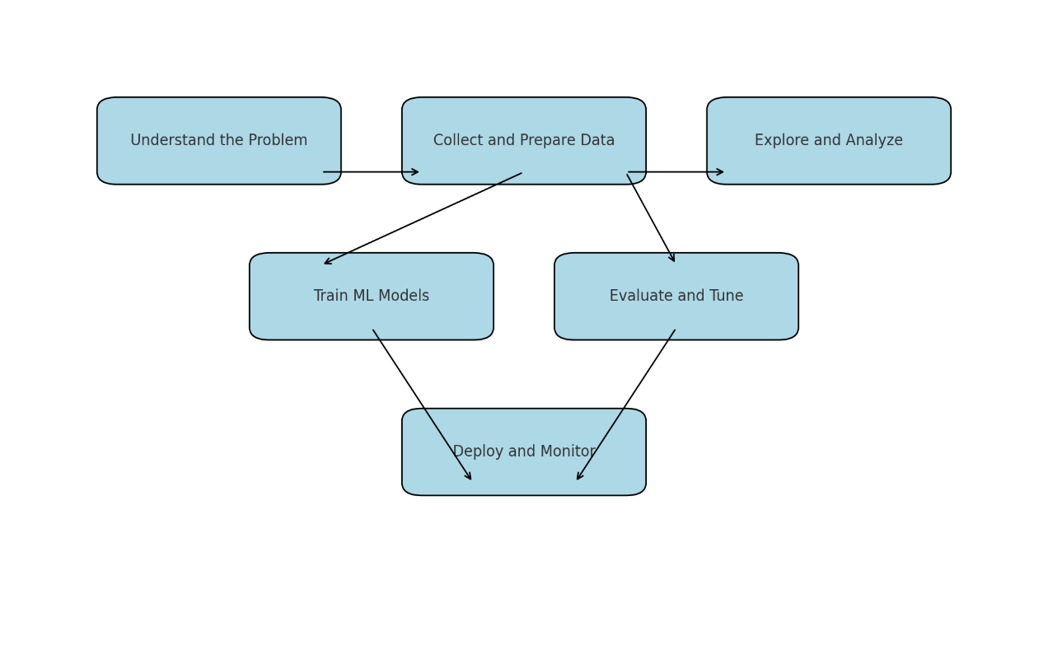
Objectives
Deploy models (Isolation Forest, Autoencoder) as a secure, low-latency API.
Ensure scalability and real-time monitoring for production use.
Notes:
FTs like precision agriculture, remote sensing & AI-powered forming equipment can help increase agricultural productivity in LDCs. This can improve fiid security & contribute to the achievement of SDG 2 (Zero Hunger).

Slide 6
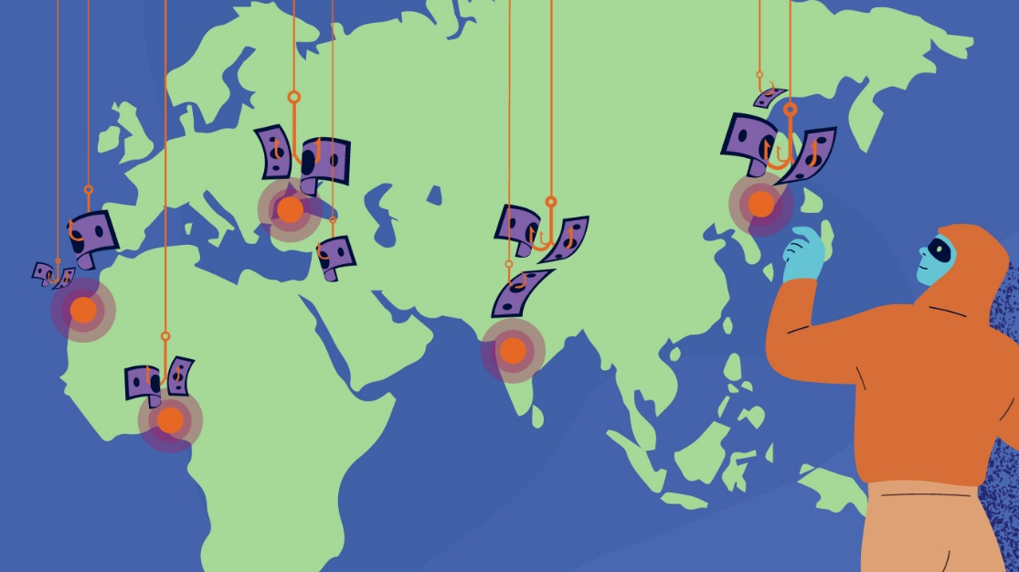
SDG Relation
Fraud undermines trust in financial institutions; detection tools strengthen accountability.
Scalable ML solutions can be deployed globally, especially in underserved regions.
Contributes to SDG 16 targets for reducing illicit financial flows.
Scalability: Deployable in emerging economies with limited fraud detection infrastructure.
Notes:
FTs like precision agriculture, remote sensing & AI-powered forming equipment can help increase agricultural productivity in LDCs. This can improve fiid security & contribute to the achievement of SDG 2 (Zero Hunger).

Slide 7
Data
Notes:
FTs like precision agriculture, remote sensing & AI-powered forming equipment can help increase agricultural productivity in LDCs. This can improve fiid security & contribute to the achievement of SDG 2 (Zero Hunger).

Slide 8
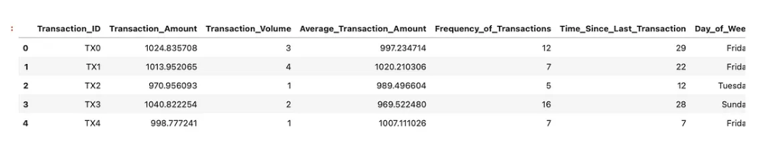
Data Collection
Dataset: Anonymized transactions with features like amount, account type, day of week, and customer age.
Preprocessing: Handled null values, encoded categories, normalized numerical features.
Notes:
FTs like precision agriculture, remote sensing & AI-powered forming equipment can help increase agricultural productivity in LDCs. This can improve fiid security & contribute to the achievement of SDG 2 (Zero Hunger).

Slide 9
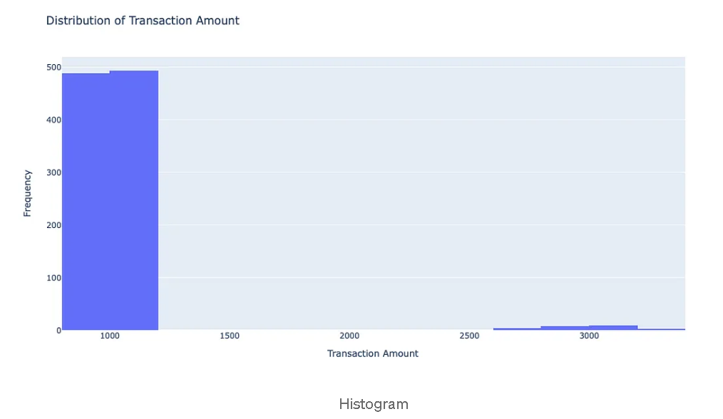
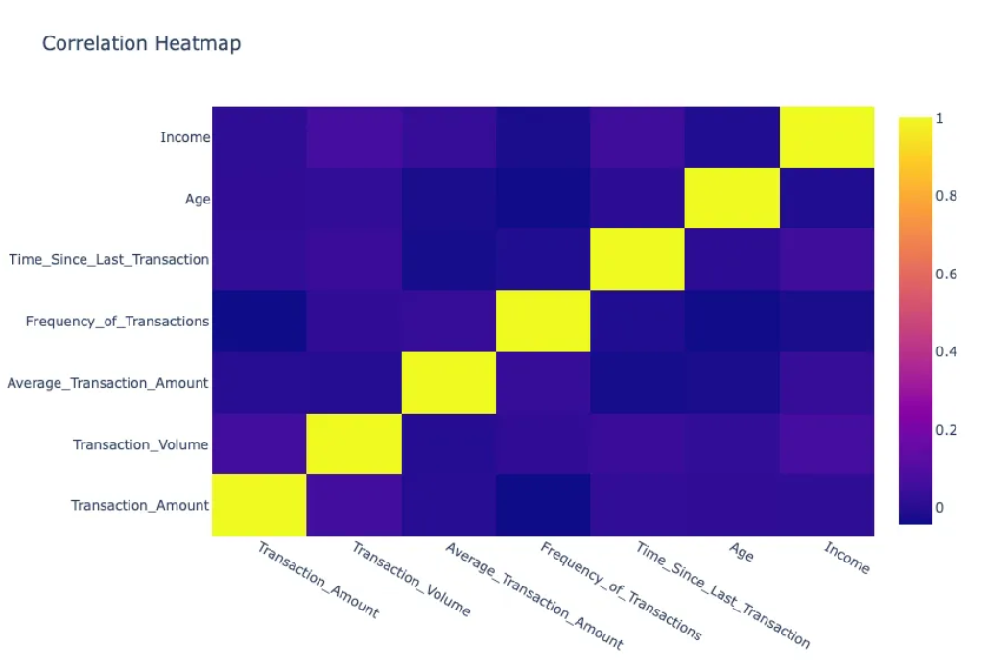
Exploratory Data Analysis and Feature Engineering
Skewed transaction amounts; business accounts showed higher variance.
Low correlation between age and transaction volume.
Notes:
FTs like precision agriculture, remote sensing & AI-powered forming equipment can help increase agricultural productivity in LDCs. This can improve fiid security & contribute to the achievement of SDG 2 (Zero Hunger).

Slide 10
Model
Notes:
FTs like precision agriculture, remote sensing & AI-powered forming equipment can help increase agricultural productivity in LDCs. This can improve fiid security & contribute to the achievement of SDG 2 (Zero Hunger).

Slide 11
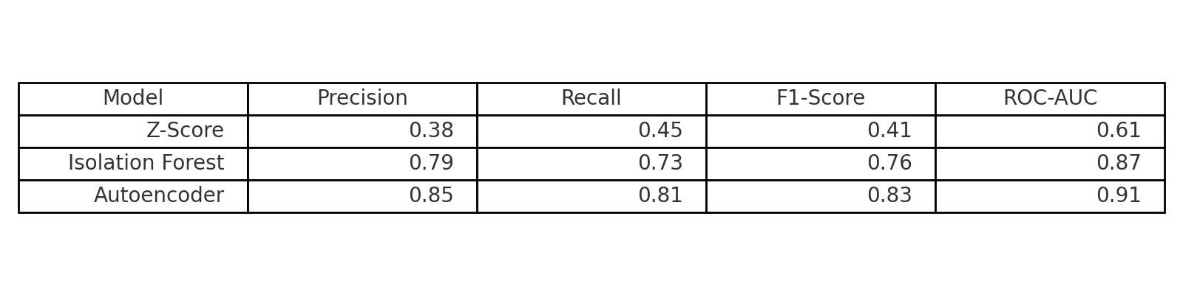
Model Selection and Training
Three models were tested:
Z-Score: Simple but limited (ROC-AUC: 0.61).
Isolation Forest: Efficient for high-dimensional data (ROC-AUC: 0.87).
Autoencoder: Best for subtle anomalies (ROC-AUC: 0.91).
Notes:
FTs like precision agriculture, remote sensing & AI-powered forming equipment can help increase agricultural productivity in LDCs. This can improve fiid security & contribute to the achievement of SDG 2 (Zero Hunger).

Slide 12
Model Evaluation and Hyperparameter Tuning
Z-Score: ±2 SD flag threshold
Isolation Forest: 100 trees, contamination=0.01
Autoencoder:
Layers: 64-32-64,
Epochs: 50,
Loss: MSE
Metrics used: ROC-AUC, Precision, Recall, and F1-score
Notes:
FTs like precision agriculture, remote sensing & AI-powered forming equipment can help increase agricultural productivity in LDCs. This can improve fiid security & contribute to the achievement of SDG 2 (Zero Hunger).

Slide 13
Model Refinement and Testing
Fine-tuned threshold based on reconstruction errors.
Tested on unseen data and evaluated generalization.
Balanced trade-off between sensitivity and false positives.
Notes:
FTs like precision agriculture, remote sensing & AI-powered forming equipment can help increase agricultural productivity in LDCs. This can improve fiid security & contribute to the achievement of SDG 2 (Zero Hunger).

Slide 14
Results
Notes:
FTs like precision agriculture, remote sensing & AI-powered forming equipment can help increase agricultural productivity in LDCs. This can improve fiid security & contribute to the achievement of SDG 2 (Zero Hunger).

Slide 15
Evaluation Results
Notes:
FTs like precision agriculture, remote sensing & AI-powered forming equipment can help increase agricultural productivity in LDCs. This can improve fiid security & contribute to the achievement of SDG 2 (Zero Hunger).

Slide 16
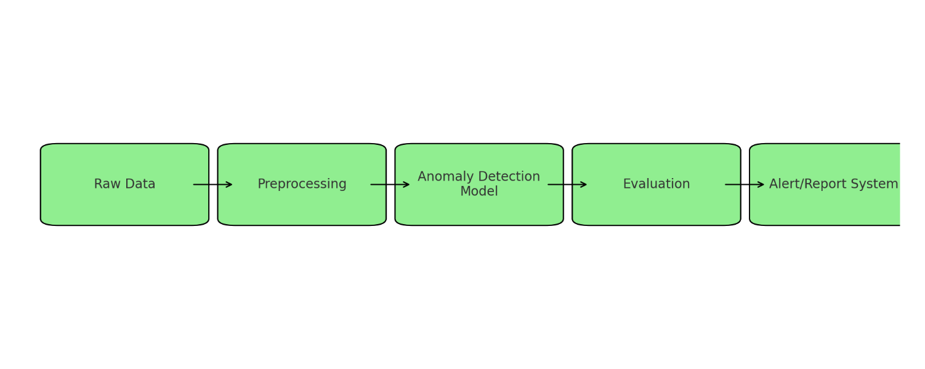
Deployment
Layered strategy: Combine Z-score (fast filtering) with Autoencoder (detailed analysis).
Real-world impact: Reduce fraud losses, enhance trust in digital finance.
Notes:
FTs like precision agriculture, remote sensing & AI-powered forming equipment can help increase agricultural productivity in LDCs. This can improve fiid security & contribute to the achievement of SDG 2 (Zero Hunger).

Slide 17
Future Work
Incorporate transaction metadata (location, device ID).
Stream processing with Apache Kafka for real-time detection.
Explainable AI dashboards for stakeholder transparency.
Try semi-supervised techniques to incorporate known fraud patterns.
Notes:
FTs like precision agriculture, remote sensing & AI-powered forming equipment can help increase agricultural productivity in LDCs. This can improve fiid security & contribute to the achievement of SDG 2 (Zero Hunger).

Slide 18
References
Scikit-learn documentation
TensorFlow Autoencoder tutorial
UN SDG 16 official page: https://sdgs.un.org/goals/goal16
Hypothetical internal dataset
Notes:
FTs like precision agriculture, remote sensing & AI-powered forming equipment can help increase agricultural productivity in LDCs. This can improve fiid security & contribute to the achievement of SDG 2 (Zero Hunger).

Slide 19


Thank you!

